Slide 1

Who are you?
For yourself and for your environment
1
DISC
personality analysis
Introduction to the course
by Jan Bollen
j.w.bollen@saxion.nl

Slide 2
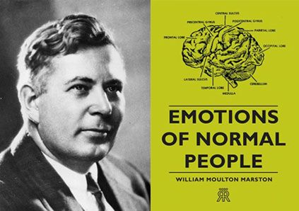
William Moulton Marston
1928
USA
2

Slide 3
3
Agenda
Job interview
Analyse behaviour
Types of persons
Dominance
Influence
Steadiness
Compliance
Competences
Overused strength
Results
Test online

Slide 4

Job interview
4
My name is …
My education is …
My …

Slide 5
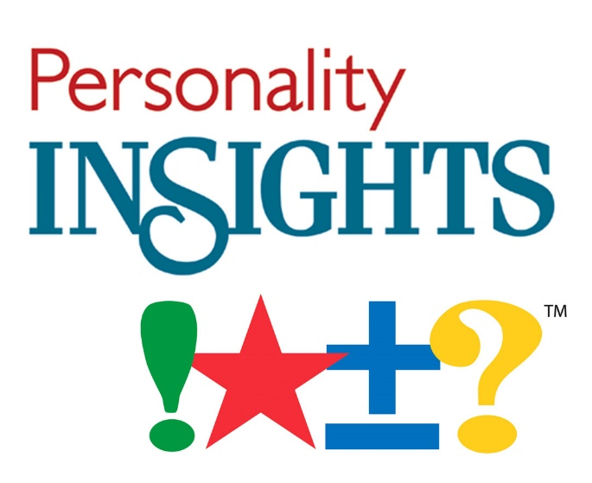
Analyse behaviour ?!?
5
Discover behavioural strengths.
Recognize weakness.
Recognize stimulus.
Learn how behaviour impacts on work effectiveness.
Recognize behavioural differences,
and improve team dynamic.
Insight / approach with communication challenges.
Enhance individual performance to a team.
Reduce conflicts and stress.

Slide 6
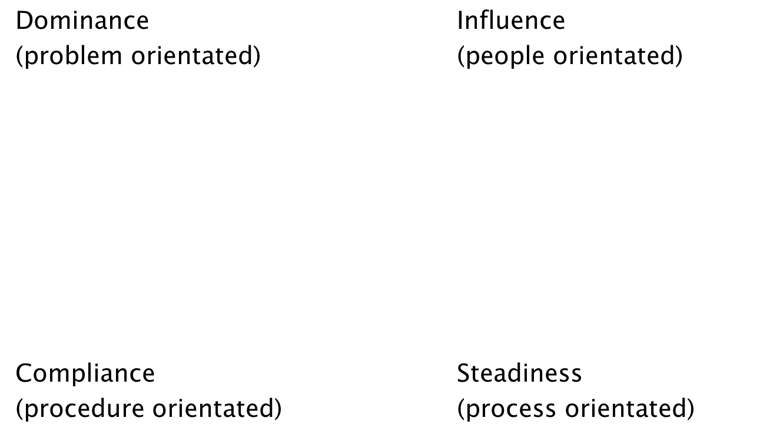
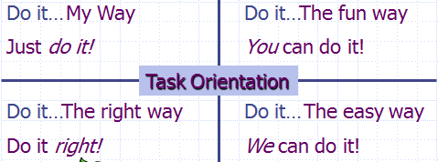
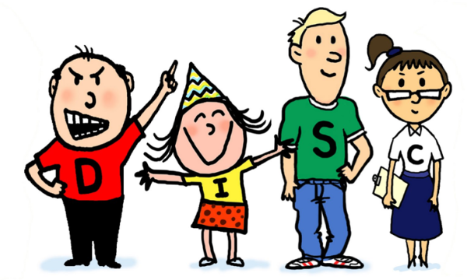
Types of persons
6

Slide 7
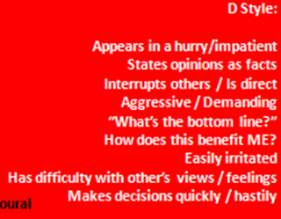
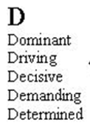

Dominance / Driver
7

Slide 8
Dominance / Driver
More WHAT questions than HOW
8
High D individuals may
- be described as:
Risk, Decisive, Self assured, Willing to learn, Competitive, Self steering, Adventurous.
- have jobs as:
Entrepreneurs, Leaders,
Sales (full commission),
Sales management

Slide 9
Communicating with D
9
If your colleague is high in D:
Focus on solutions, not problems
Give the bottom line
Focus your discussion narrowly
Avoid making generalisations
Don’t repeat yourself
Be brief and speak up

Slide 10
Dominance / Driver
10
Will improve by:
slow patience
display sensitivity
get into the details
allow deliberation

Slide 11
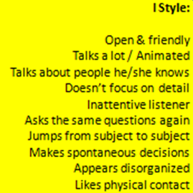
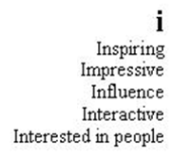
Influence / Inspiring
11

Slide 12
Influence/ Inspiring
More WHO questions than WHY
12
High I individuals may
- be described as:
Enthusiastic, Trusting, Emotional, Impulsive, Pleasant, Group person, Self-promoting, Influential, Sociable.
- have jobs as:
Advertising / marketing, Public Relations, Training, Hospitality

Slide 13
Communicating with I
13
If your colleague is high in I:
Allow them time to ask questions
Focus on the positive
Avoid detail overload
Don’t interrupt
Share your experiences

Slide 14
Influence/ Inspiring
14
Will improve by:
focus on details
research all the facts
speak directly
stay focused for long periods

Slide 15
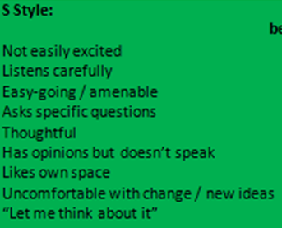

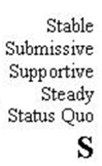
Steadiness / Stable
15

Slide 16
Steadiness / Stable
More HOW questions than WHAT
16
High S individuals may
- be described as:
Patient, Team-person, Passive, Possessive, Relaxed, Loyal, Predictable, Serene, Inactive.
- have jobs as:
Teaching, Finance, Human recourses, Administration, Manufacturing

Slide 17
Communicating with S
17
If your colleague is high in S:
Express your interest & what you expect
Avoid being too aggressive
Take time to clarify
Be polite

Slide 18
Steadiness / Stable
18
Will improve by:
quickly adapt to change or unclear expectations
multitask
promote themselves
confront others

Slide 19
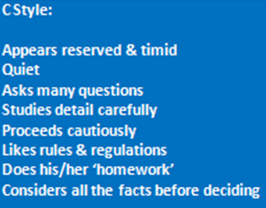
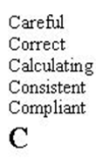
Compliance / Correct
19

Slide 20
Compliance / Correct
More WHY questions than WHO
20
High C individuals may
- be described as:
Perfectionist, Fact-finder, Systematic, Correct, Calm, Accurate, Diplomatic, Conventional.
- have jobs as:
Accounting, Auditing, Engineering, Quality control, Computer programming

Slide 21
Communicating with C
21
If your colleague is high in C:
Be patient, persistent and diplomatic
Minimise ‘pep talk’
Minimise emotional language
Focus on facts and details

Slide 22
Compliance / Correct
22
Will improve by:
delegate tasks
compromise for the good of the team
join in social events and celebrations
make quick decisions

Slide 23
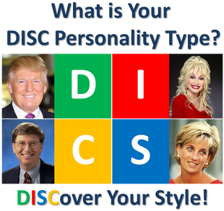
Types of persons
23
Donald Trump /
President of the USA
Dolly Parton /
American singer
Diana Spencer /
Princess of Wales
Bill Gates /
Founder of Microsoft

Slide 24
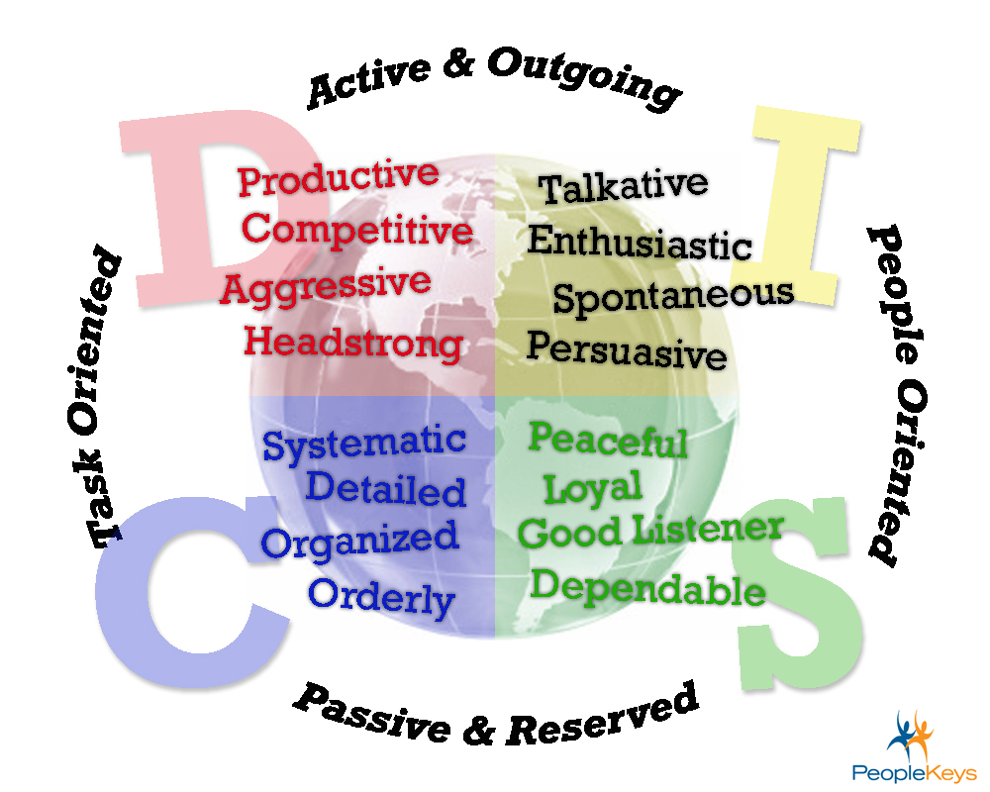

Competences
24

Slide 25
Strengths Overused can Become Weaknesses
25
D who is good at leadership and deciding, may become arrogant.
I who is good at promoting and convincing, may oversell and manipulate.
S who is steady and agreeable, may become underperforming and shy.
C who is good at analyzing and checking, may become perfectionistic and indecisive.

Slide 26
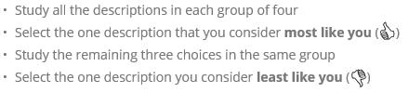
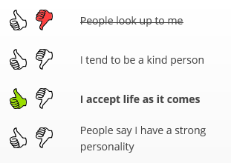
Test on line
26
DISC test is on line
http://www.123test.com/disc-personality-test/
Result:
DISC figure
and
Personality description in words

Slide 27


My results?
27

Slide 28
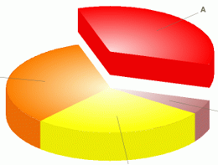

Result in figure
D = 35 %
I = 33 %
S = 27 %
C = 5 %
28
D
I
S
C

Slide 29
Result in text
29
Your DISC personality type
You have a strong inner motivation to influence people and circumstances. You thrive on competitive situations and challenging assignments. The stresses and pressures of everyday work and life are unlikely to reduce your effectiveness and enthusiasm.

Slide 30
Assignment
30
Make the on line test NOW and save the results in “”picture”” and in “”text””.

