Slide 1
Writing a Curriculum Vitae (CV) and an application letter
1
by Jan Bollen
j.w.bollen@saxion.nl

Slide 2
2
Importance
Attention of CV
First impression
Lay-out, grammar
Why and what
Standard or personal?
Suggested CV lay-out
Personal data
Education
Work experience
Agenda
Computer skills
Personal skills
Languages
Hobbies
References
Be aware
Application letter structure
Application letter aim
Lay-out

Slide 3
Importance
3
Vital importance for a suitable job
Good CV boost your chances for interview
Always compared with others

Slide 4
Attention of CV
4
The first person who handle your CV
Spend 1 minute to;
Scan
Compare
Decide to read yes / no

Slide 5
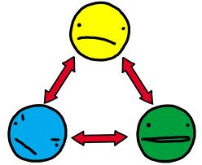
First impression
5
Positive
Good lay-out
No language mistakes / complete
Negative
Chaotic
Language faults / incomplete
So …. spent time to make a GOOD CV

Slide 6
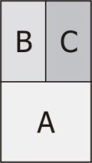
Lay out
6
Relaxed, not too fancy
One letter type
Clear heading
Time line from now to the past
Every page your name
Page numbering and total pages
Use white paper

Slide 7
Grammar
7
Always check your grammar
It should be perfect!
Ask someone to ‘proof read’ your CV

Slide 8
Why and what
8
Which company
Which job
What is important information
State personal qualities
State hobbies also
Comparison will be made on EXTRA things

Slide 9
Standard vs Personal ?
9
Do not copy standard CV
CV should be personal
If you copy a CV the company will think
Not creative
Not spending time in it
Not serious

Slide 10
Suggested CV lay out
10
Headers and footers (name, page numbering)
Personal data
Education
Work experience
Computer skills
Personal skills
Languages
Hobbies
References

Slide 11
Personal date
11
Include
your name, address, phone numbers, male / female, date of birth, nationality, marital status, driving licence & photo (voluntarily)
Add an email address that is checked regularly
and seems professional!
Sweet_girl@hotmail.com Big_boy@hotmail.com

Slide 12
Education
12
Briefly list education
Last education first, include
type of degree
name of University, location and
anticipated date of graduation
List other degrees
relevant higher education / coursework
ongoing professional education
training courses and study abroad

Slide 13
Work experience
13
Every work experience is important
State
Company name and type
Function
Responsibilities or activities
It tells something about your competences

Slide 14
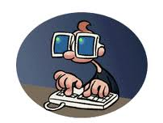
Computer skills
14
List in short the general programs such as windows 10, MS office
List in specific also technical programs, such as Microcap, Labview, MultiSim, Mathlab, Java, C …..

Slide 15
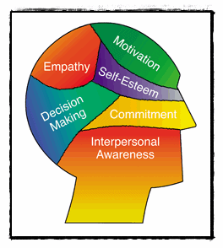
Personal skills
15
Characterisation of your person in a word list
You can use DISC test
https://www.123test.com/disc-personality-test/
https://www.123test.nl/disc-test/
Team player
Listener
Discipline
Accurate
Initiative …

Slide 16
Languages
16
Make a table of languages:
Speaking Reading Listening Writing

Slide 17
Hobbies
17
Social life is very important
In the beginning everybody have
the same qualifications
Something has to make the difference
From the hobbies they can tell what
kind of person you are

Slide 18
References
18
Maximal 2 references
Be sure to contact your referees in advance,
so they are prepared
Be aware - some employers will check your references for accuracy

Slide 19
Be aware
19
Sent it always in PDF
Portable Document Format
It is not changeable
Format stays always the same

Slide 20
Application letter
20
Structure
Heading from / Heading to
Salutation
Introduction
Body
Ending
Attachment

Slide 21
Application letter
21
Aim
Present an overview of yourself
in lines in 1 page.
Introduction:
why do you write the letter?
Body:
explain your interest in this special company, explain your goals in life and prove your personal skills by examples. Give an outlook in what direction you want to develop yourself.

Slide 22
Application letter
22
Ending:
thank for attention and ask for an interview
Signature:
do not forget the signature !!
Attachment :
always sent the CV with it

Slide 23
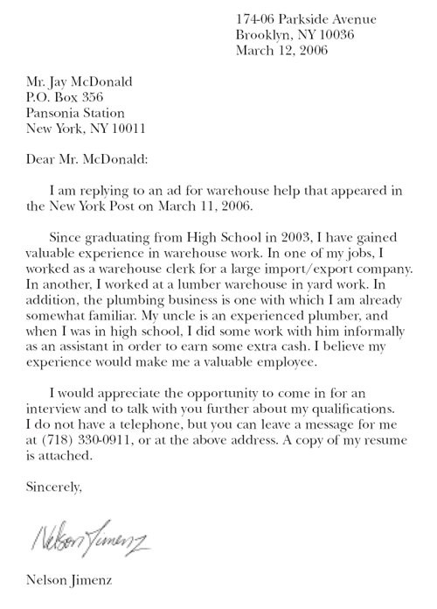
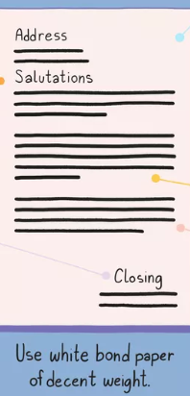
Lay out
23
Heading
from who
Heading
to who
Salutation
Introduction
Body
Closing
Signature
Attachment

