Slide 1


Oral presentation techniques
1
by Jan Bollen
j.w.bollen@saxion.nl

Slide 2
2
Situation
Title
Structure
Agenda
Storyline
Slides
Practice
Guestures
Eye-contact
Breathing
Voice
Repetition
Introduction
Body
Key points
Conclusion
Questions
Ending
YES YOU CAN
CONFIDENCE
Agenda

Slide 3
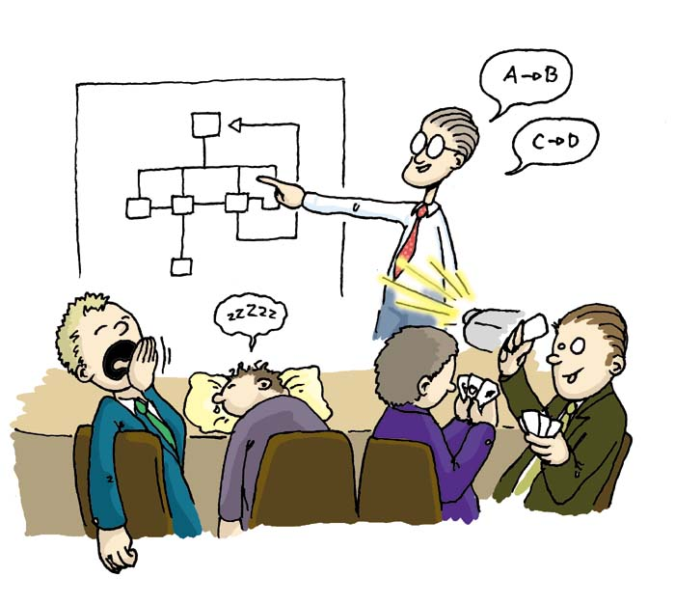
Situation
3
Consider the audience carefully !!
How big?
Who?
Level of knowledge?
Level of interest?
Resistance?
Time?

Slide 4
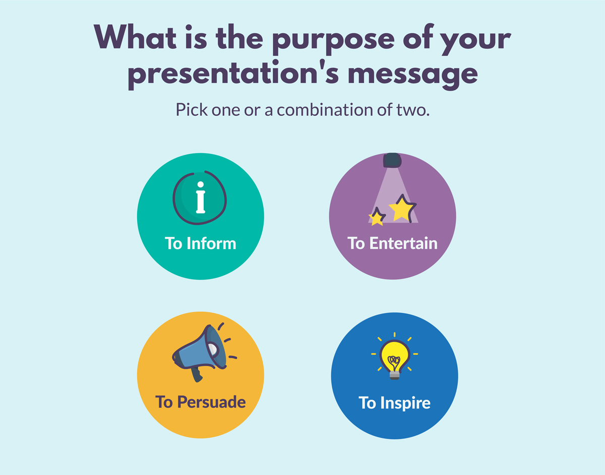
Title, define your title in 1 short sentence be short, direct
4

Slide 5
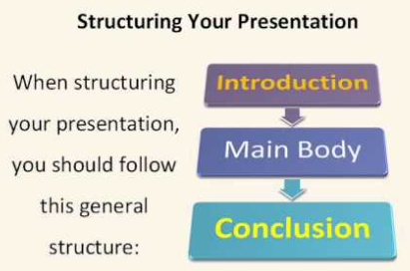
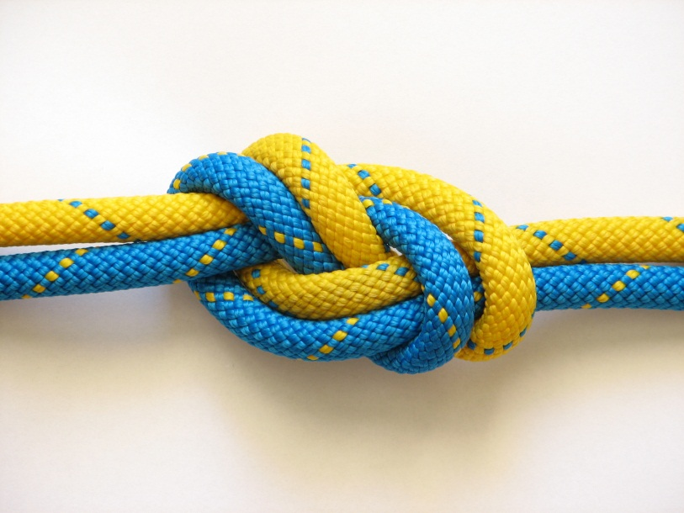
Structure
5
Basic structure
State questions during or after presentation

Slide 6


Agenda
6
State main topics
State questions during
or after presentation
If needed ask; turn off mobile phones

Slide 7
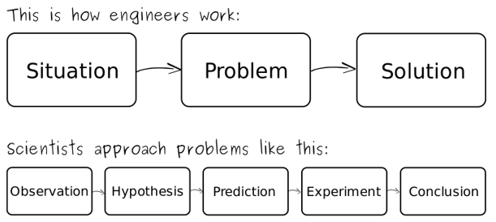

Storyline
7
Logically structure in body

Slide 8
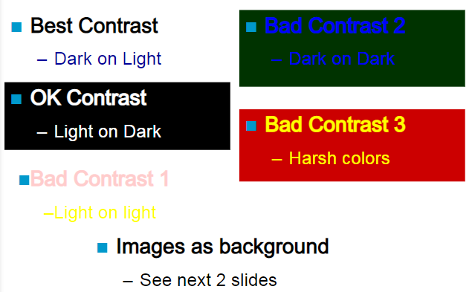
Slides, use one key message per slide
8
  Keep it simple, List key points
  Make letters large, Use colour

Slide 9
Visual aids
9
Use visual aids to maximize the effectiveness of your presentation.
visualise ideas
keep speaker on track
generate interest
help information retention

Slide 10
Practice
10
Adequate rehearsal is essential for a good presentation
Development of each visual
Self-confidence
Timing
Practice Makes Perfect !!

Slide 11
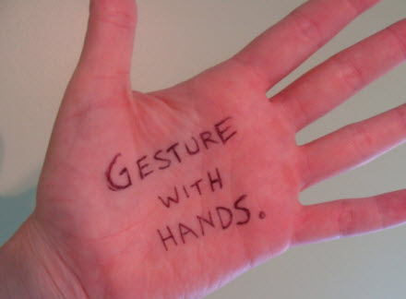
Gestures
11
Important in non-verbal communication
Emphasize points / Highlights
Audience attention

Slide 12
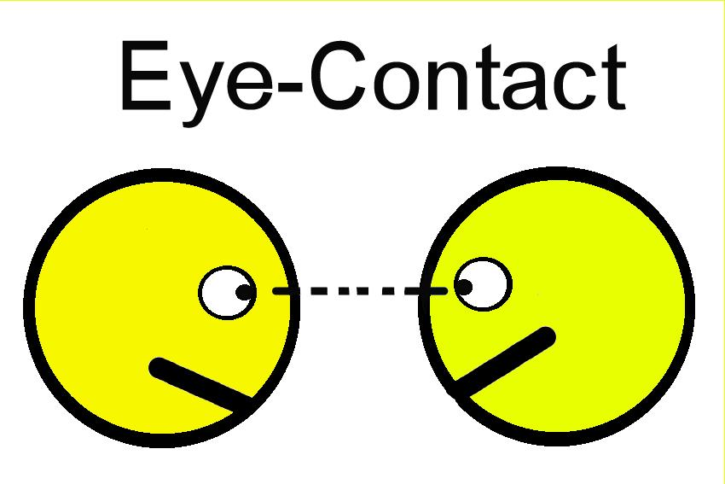
Eye contact
12
Look at each member of your audience
Involvement
Trust / support
Interest
Spontaneous reaction

Slide 13

Breathing
13
Breathing is different from normal breathing.
Breathing deeper for
  Volume control
  Emphasis (accents)

Slide 14

Voice
14
Critical part of a verbal presentation
Volume - speak to be heard
Modulation – vary the voice
Pause – make

Slide 15
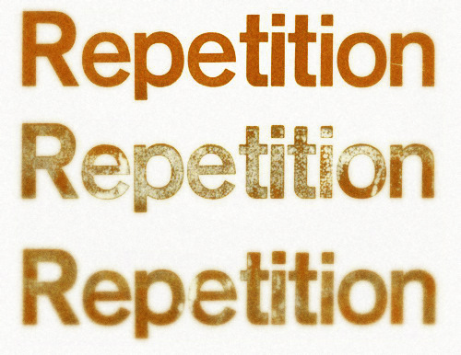
Repetition
15
Golden rule:
repetition
is valuable
Say what you are going to say,
Say it,
Say what you have just said.

Slide 16
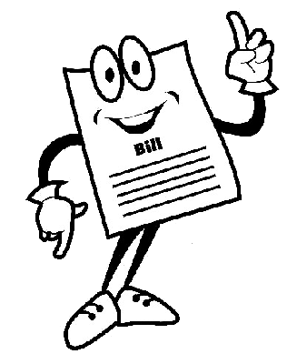
Introduction
16
Very important
First impression
Getting contact
Welcome your audience
Introduce your subject
Outline the structure of your presentation
Give instructions about questions

Slide 17

Body
17
The body is the 'real' presentation. If the introduction was well prepared and delivered, you will now be 'in control'. You will be relaxed and confident.
The body should be well structured, divided up logically, with plenty of carefully spaced visuals.

Slide 18

Key points
18
Do not hurry
Be enthusiastic
Use questions / use pauses
Give time on visuals / Eye contact
Modulate your voice / Look friendly
Remain polite when dealing with difficult questions

Slide 19

Conclusion
19
Use the conclusion to:
Sum up
Give recommendations if appropriate
Thank your audience
Invite questions

Slide 20

Questions
20
Be polite
Repeat questions for the audience.
Reformulate a question
Difficult questions answer later
Stupid questions;
out of range of presentation

Slide 21

Ending
21
Strong closing
You hope it was interesting
Thanking the audience for attending
Hope to see you next time

Slide 22

Yes YOU can
22
Any professional can become an effective presenter.
Knowledge is not enough.
Being able to communicate is equally important.
Investing time and effort in improving presentation skills is “always rewarded”.

Slide 23

Confidence ?
23
What is confidence?
Is it important?
How to improve?
Is it depending on other persons?
You feel shy?
You feel negative?
You feel underdog?

Slide 24




Confidence !
24

