Slide 1

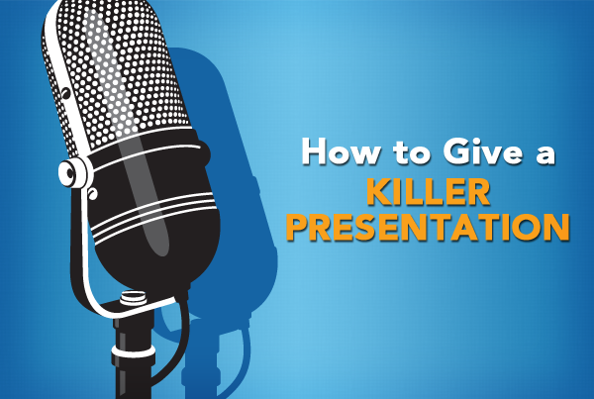
Oral presentation
Pecha Kucha,
Ignite
Elevator pitch
1
by Jan Bollen
j.w.bollen@saxion.nl

Slide 2
2
Agenda
Classical presentation
Pecha Kucha presentation
Ignite presentation
Elevator pitch
Assignment

Slide 3
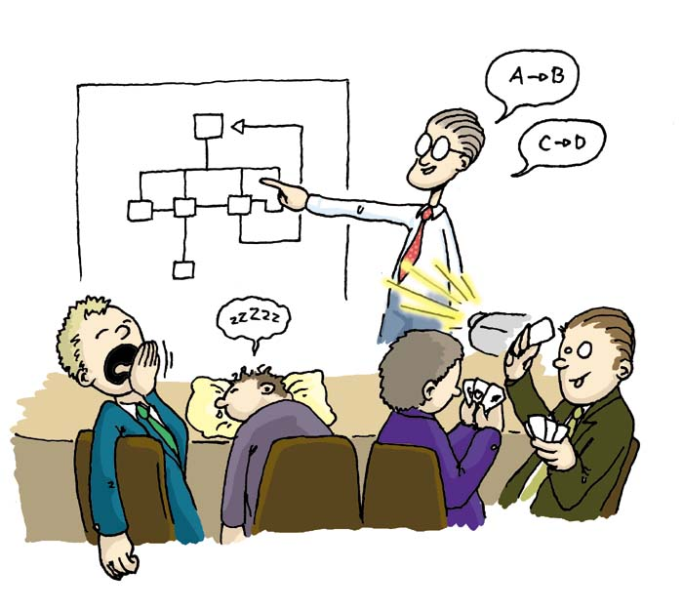
Situation
3
A presentation should;
Inform
Inspire
Instruct
Entertain
Educate
Motivate

Slide 4
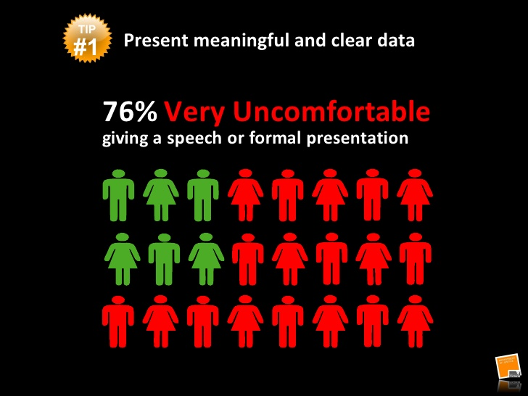
Classical presentation
4

Slide 5

Classical presentation
5
Takes a long time
Needs a lot of attention of the audience
Not always efficient

Slide 6
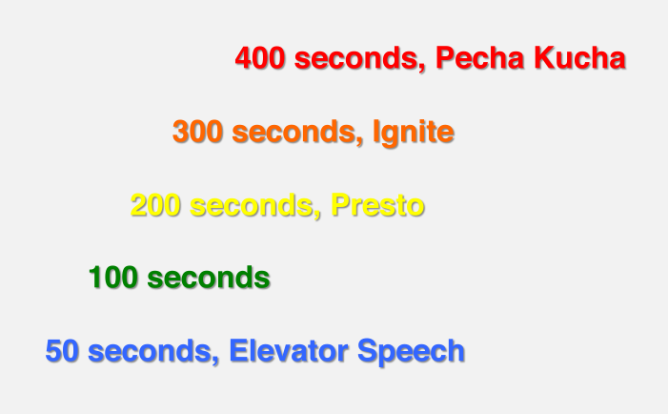
Variations
Pecha Kucha
Ignite
Presto
Elevator Speech
6
Designed to be more efficient in transferring your ideas / message

Slide 7



Presentations we can use
7
Pecha Kucha
Ignite
Elevator pitch

Slide 8

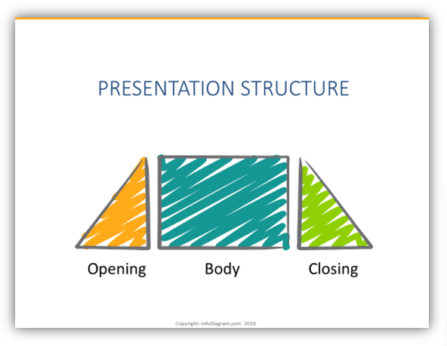
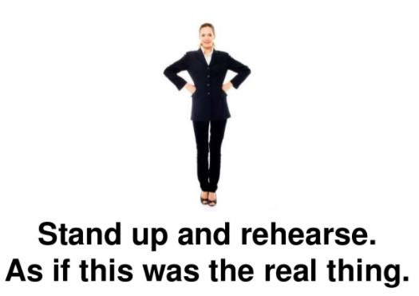
Expectations
8

Slide 9
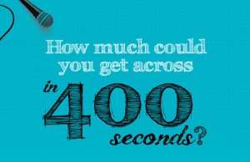
Pecha Kucha
9
Designed in Japan
Pecha Kucha = Chit Chat
Short presentation structure
Structure 20 slides for 20 seconds
= 6:40
Automatic presentation

Slide 10
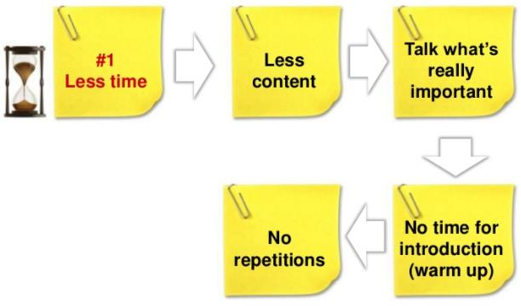
Pecha Kucha time control
10
Focus
Story line
Stimulates creativity

Slide 11
Pecha Kucha design
11
Choose topic
Get graphics
Add text simple and short (key words)
Keep animation to a minimum
Make slides in Power Point
Adjust automatic transition (20 sec.)
Practice practice practice

Slide 12
Ignite
12
Designed Seattle Washington (2006)
Inspired by Pecha Kucha
Short presentation structure
Structure 20 slides for 15 seconds
= 5:00
Automatic presentation

Slide 13
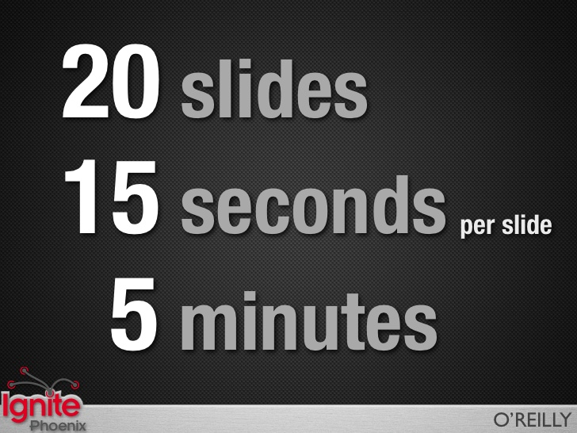

Ignite structure
13

Slide 14
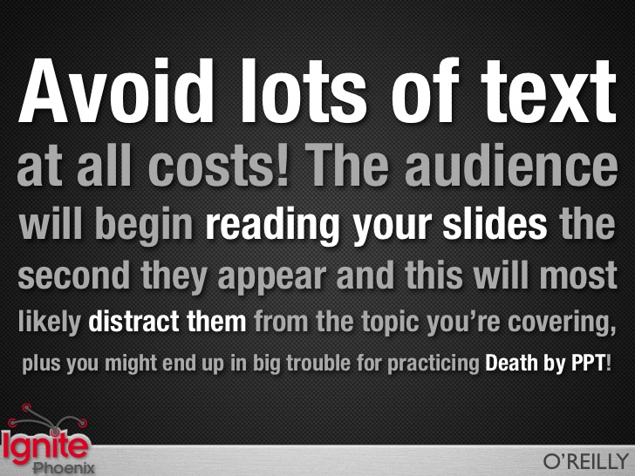
Ignite do not
14
Contrast;
no red letters
on black
background
Transparency;
No text in a picture

Slide 15
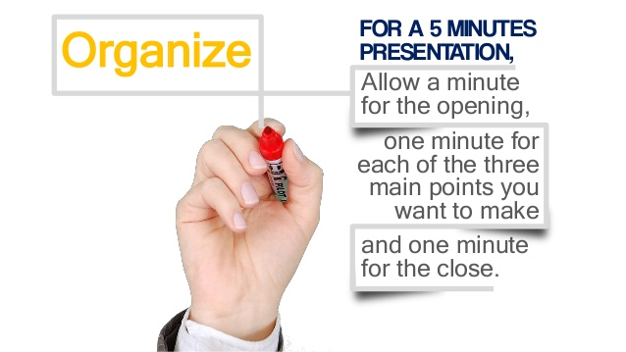
Ignite organize
15

Slide 16
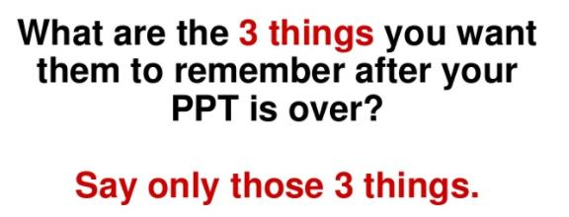
Ignite design
16
Story line:
Top-Down
Important- less important
Main or global - detail

Slide 17
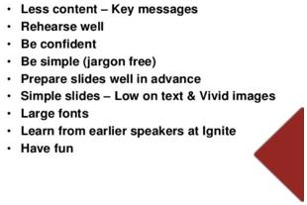
Ignite summary
17

Slide 18
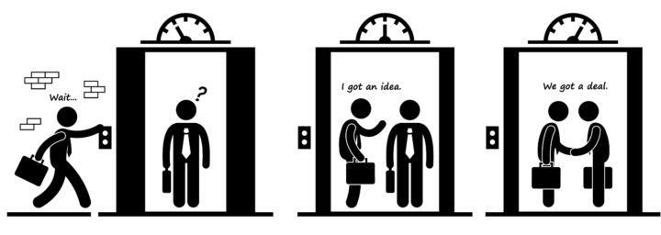
Elevator pitch
18
Goal:
get attention in a very short time

Slide 19


Elevator pitch
60 seconds
19
Sending condensed information;
Intro–Problem–Solution–Action/Ask

Slide 20
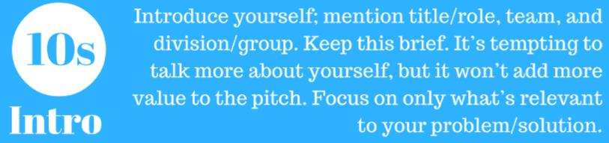

20
My name is Jan Bollen, I work at the university of applied science Saxion, Enschede, The Netherlands. My focus point is to develop the personal professional development for bachelor students in the engineering field.

Slide 21
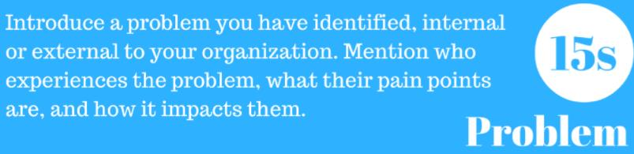
21
I have discovered that engineering students have a problem to do an application interview to get a job. They cannot present themselves well, they are shy, nervous and have a lack of self knowledge.

Slide 22
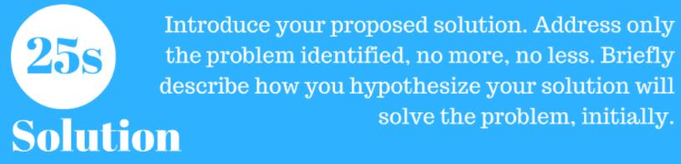
22
I think it is good that students do a training in how to write a CV, know what companies expect, how to do a oral interview and let them know themselves better. For that I can offer a training theoretically and practical and I can give these students also personal guidance.

Slide 23

23
Perhaps you are interested in my idea and we can work together? If you are interested I can sent you all the detailed information about my idea? Shall we exchange phone numbers or e-mail to continue our fresh cooperation?

Slide 24
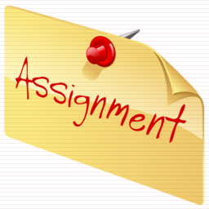
Assignment
24
Make a ignite presentation in power point
20 slides 15 seconds each automatically
Subject to choose is free
  Your personality or hobbies
  Your country, or traditions
  Your future goal in professional work

Slide 25
Assignment deliver
25
Rehearse rehearse rehearse at home
Upload the ppt in blackboard first
Before you do the presentation in class
Bring also the ppt on USB stick in class
Remember you are here to learn, so do not be shy or anxious to make faults.
Practice can make you better.

